Slide 1
ADIDAS US MARKET ANALYSIS
PRESENTED BY:
AKPAN, INEMESIT EDET
24TH OCTOBER,2024

Slide 2

INTRODUCTION
Adidas is a prominent global brand in sports apparel and footwear, operating in a highly competitive market. To maintain its market share and foster growth, the company must continually analyze its sales performance, customer preferences, and the effectiveness of its marketing strategies. This analysis leverages the Adidas dataset to offer actionable insights into sales trends, customer behavior, and marketing performance.
In this report, I provide a detailed analysis of Adidas sales data using Excel. This personal project aims to improve my data analysis skills by utilizing Excel’s data manipulation and visualization tools to lay bare important insights into sales performance, trends, and patterns. Join me as I explore the data to highlight valuable information that can inform strategic decision-making and improve business outcomes for Adidas.

Slide 3
DATASET
The dataset utilized for this analysis was sourced online from Kaggle and encompasses Adidas sales data from 2020 to 2021. It features comprehensive information on sales transaction, including product categories, quantities sold, sales revenue, and regional sales performance. This dataset serves as a strong foundation for constructing insightful analyses of sales trends and patterns across these two years, allowing for a deeper understanding of market dynamics and strategic opportunities.

Slide 4
ANALYSIS SUMMARY
The analysis was conducted using Excel, and I approached it through a structured process outlined below:
Data cleaning:
To ensure the dataset’s quality, I conducted a thorough evaluation focusing on consistency, reliability, completeness, duplicates, and spelling errors. Verification checks were systemically performed, reinforcing the integrity and cleanliness of the data.
Data Analysis:
I employed pivot tables for calculations and aggregations, which proved effective in uncovering valuable insights from the dataset.
Data Visualization:
To effectively communicate the analysis results, I utilized a variety of Excel charts, including those derived from pivot tables. I also incorporated slicers to enhance interactivity and improve the overall usability of the dashboard, making it more accessible for users.

Slide 5
QUESTION PHASE
For this analysis, I will focus on the following key questions to gain deeper insights:
What is the total sales amount generated by each retailer?
How does the proportion of sales from each method compare to the overall total sales?
Which three retailers have made the most significant contributions to total sales?
What trends can we observe in sales performance over time?
By addressing these questions, we can better understand the sale landscape and identify areas for improvement.

Slide 6
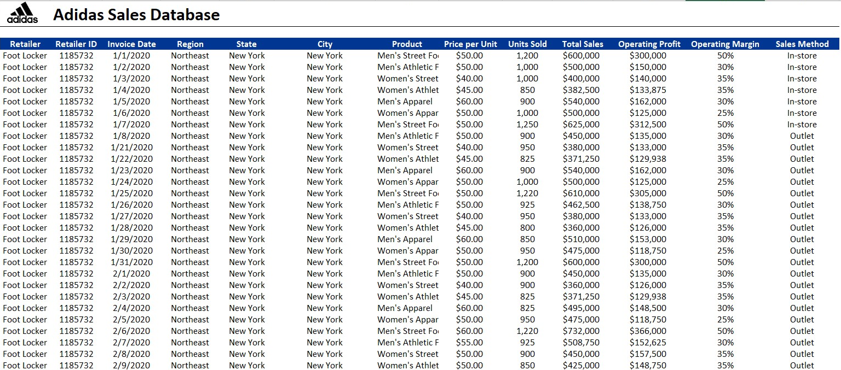
ADIDAS SALES DATASET
A sneak peek of the Adidas Dataset

Slide 7
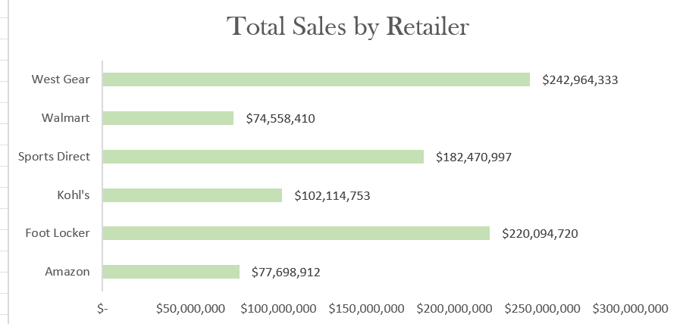
TOTAL SALES BY RETAILER
The overall sales for 2020 and 2021 combined is $899.90M.
We have a total number of six retailers.
We can see that West Gear is the highest seller providing $242.96M revenue. While Walmart and Amazon are the lowest sellers with just $74.56M and $77.69M respectively.
From my analysis, the highest sales for West Gear was made by their walk-in customers. This simply shows that West Gear is Adidas’s leading Retailer.

Slide 8
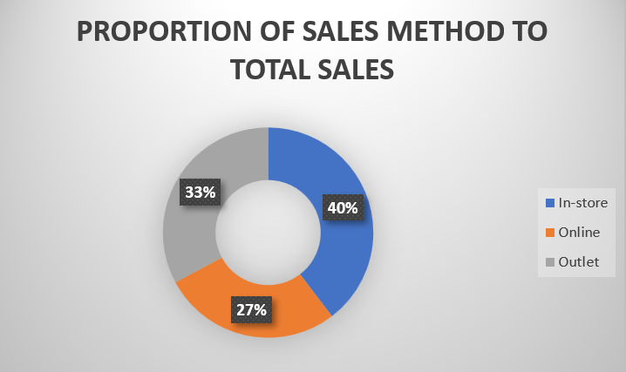
SALES METHOD SHARE DISTRIBUTION
The largest share of our overall sales was driven by in-store transactions, which represented over 38% of total sales. This emphasizes the valuable role that physical stores play in our revenue generation. As we continue to enhance our online sales channels, we can explore ways to further strengthen the contributions of our brick-and-mortar locations.

Slide 9
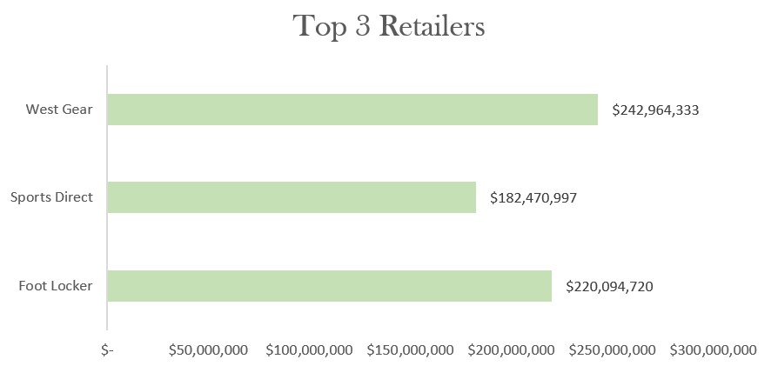
TOP PERFORMING RETAILER
West Gear, Foot Locker and Sports Direct emerge as the top retailers, collectively accounting for 72% of total sales.
West Gear, Foot Locker and Sports Direct dominates sales, indicating strong partnerships.
All three retailers likely leverage both online and physical store channels effectively, reaching a broader customer base.

Slide 10
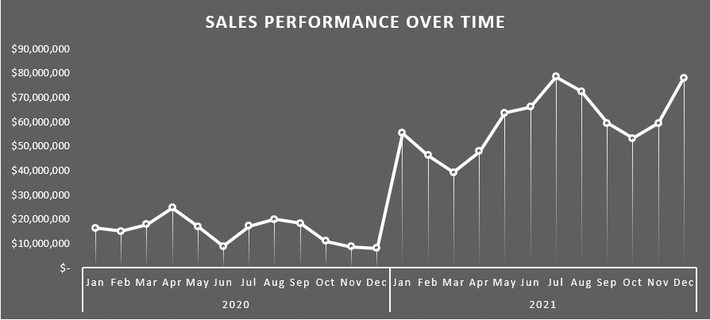
SALES TREND ANALYSIS
I conducted an analysis of the Pivot Table to identify trends over time, which offers valuable insights into the fluctuations of total sales across various months.
The data highlights a promising overall increase in total sales, despite some fluctuations. A noteworthy observation is the decline in total sales from May to June in 2020, which presents an opportunity for investigation and improvement. The line graph demonstrates a consistent upward trend in total sales, with July marking a peak in sales. This trend suggests a positive trajectory that we can build upon moving forward.

Slide 11
RECOMMENDATION
Invest in targeted online marketing campaigns, offer competitive pricing, promotions; Implement seamless omnichannel experience and leverage social media and influencer partnership to boost online sales.
Create a review box for customers to share their experiences with retailers.
The highest sales were from West Gear store; I would recommend that the store should always have all products in stock during all periods to maximize profit.
Develop strategies to enhance operations during summer, given its importance for sales. These strategies may include curating product offerings that cater specifically to customers’ needs during this season.
Continuously monitor sales performance, track key performance indicaors, and gather marketing messages.

Slide 12
CONCLUSION
The analysis of Adidas’s sales data across multiple retailers and products provides valuable insights into market performance and consumer behaviour. By leveraging these insights, Adidas can refine its marketing strategies, enhance product offerings, and ultimately improve sales across its retail network.

Slide 13
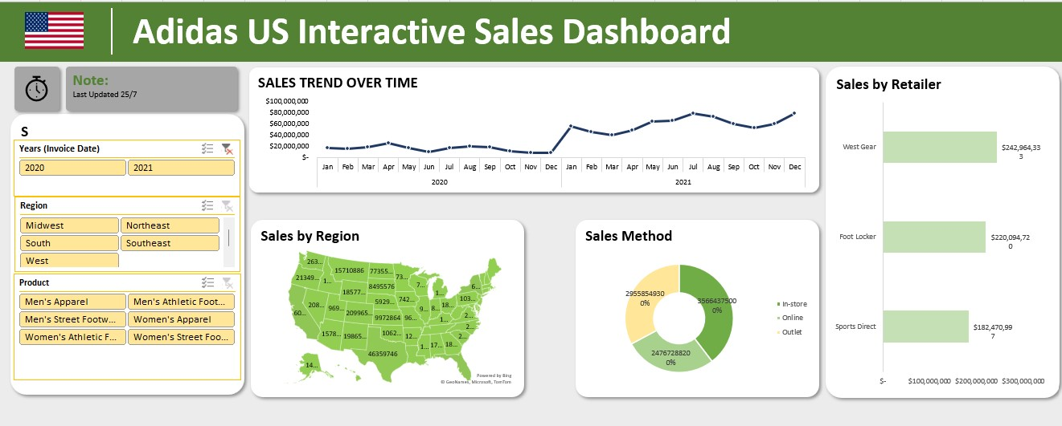
INTERACTIVE DASHBOARD

